Slide 1


Stock price forecasting & Recommendation
From - Sahil Mattoo

Slide 2

INDEX
Introduction
Why?
Scope
Framework
Methodology Explained
Demo
Future Enhancements

Slide 3
Introduction
Build a model to predict whether an individual should BUY or SELL stock of a respective holding
Model built to suit the risk appetite of different investors : Potential Risky Ones to Stable Income Players
Enables a potential investor with data driven recommendation thereby assisting him/her in making a buy/sell decision

Slide 4
Why?
Financial Markets have been a mysterious area of Study!!
Most stock predictions in market are largely based on user sentiments
Easy access and availability of data from a plethora of sources
This project is a step forward in recommending and predicting of stock value with the advantage of not only using historical data but the future hindsight as well

Slide 5
scope
Segment considered for project is the Automobile Industry
Companies considered under the Industry are : Tata, Maruti, Eicher, Ashok, TVS and Bajaj
Prediction limited to technical analysis and does not consider Socio-Economic Factors/Fundamentals of the Company and Regulatory changes
Model built for recommendations based on short term predictions
Finalized share price data is being sourced from https://finance.yahoo.com/

Slide 6

Framework

Slide 7
Yahoo Finance Service
Stock values in Xts. format
Data Pre-processing
Chainkin Money Flow
Data Frame with Technical Indicators
ARIMA
Forecast the Values
Evaluate Technical Indicators
Average Directional Index
Bollinger Bands
RSI - AROON
Historical
Vs
Future Data
Evaluate Technical Indicators
Dependent Variable
Test Data Frame
Train Model using ML
Model
Prediction

Slide 8
Methodology explained

Slide 9

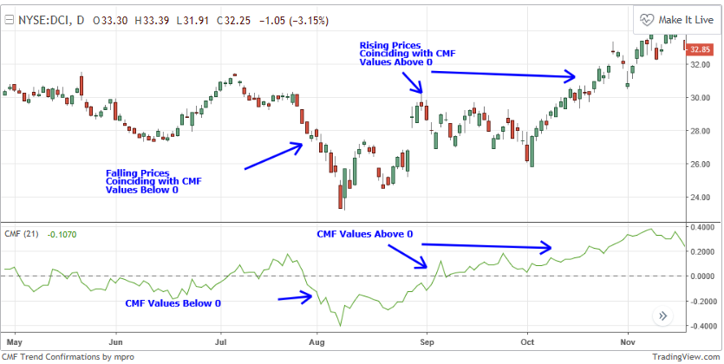
Technical indicators
There are Four categories of Technical indicators: Volume, Trend, Volatility and Momentum; that explains the health and behavior of stock price and assist investor to make a decision.
VOLUME
CMF – Chainkin Money Flow – The test describes the pattern of Accumulation/Distribution. Buying and Selling Pressure can be a good way to confirm an ongoing trend. This can give the trader an added level of confidence that the current trend is likely to continue.
Calculation
Find the Money Flow Multiplier
[(Close - Low) - (High - Close)] /(High - Low) = Money Flow Multiplier
Calculate Money Flow Volume
Money Flow Multiplier x Volume for the Period = Money Flow Volume
Calculate The CMF
21 Period Sum of Money Flow Volume / 21 Period Sum of Volume = 21 Period CMF

Slide 10
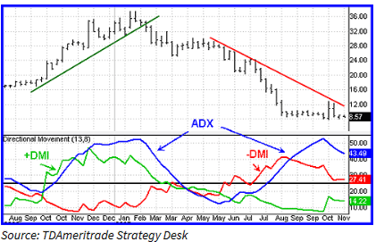
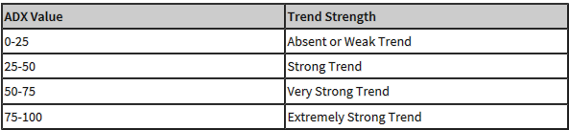
Technical indicators
TREND
ADX – Average Directional Movement Index – This is indicator of the strength of the Trend, which is interpreted in combination to positive directional indicator (+DI) and negative directional indicator (-DI).
Calculation
Directional movement (+DM and -DM) are calculated for each +DI and -DI, based on high, low, and closing prices of each period
UpMove = Today’s High – Yesterday’s High & DownMove = yesterday's low − today's low
+DM and –DM are Calculated by comparing UpMove and DownMove
+DI and –DI
+DI = 100 times the smoothed moving average of (+DM) divided by average true range
-DI = 100 times the smoothed moving average of (-DM) divided by average true range
ADX
ADX = 100 times the smoothed moving average of the absolute value of (+DI − -DI) divided by (+DI + -DI)

Slide 11
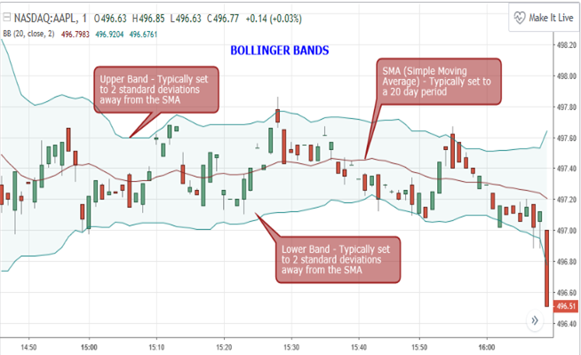
Technical indicators
VOLATILITY
Bollinger Bands are statistical charts providing the insight of price volatility. This gives trader a leverage of knowing the optimal range of the stock price before they make logical decision.
Calculation
Middle Band – 20 Day Simple Moving Average
Upper Band – 20 Day Simple Moving Average + (Standard Deviation x 2)
Lower Band – 20 Day Simple Moving Average - (Standard Deviation x 2)
As volatility increases, the wider the bands become. Likewise, as volatility decreases, the gap between bands narrows.

Slide 12
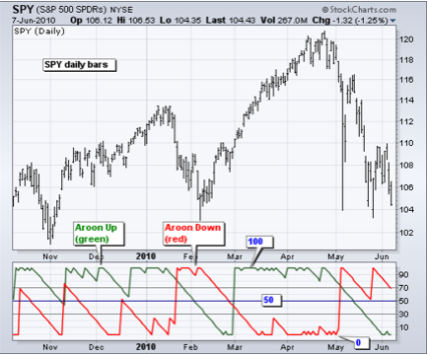

Technical indicators
MOMENTUM Is the measurement of the speed or velocity of price changes and measures the rate of the rise or fall in stock prices
RSI – Relative Strength Index – Assigns stock a value between 0 to 100 and indicates to the trader whether or not an issue's price action is created by those over-buying or over-selling it.
Formula
The Choice of RSI in SPFR is Aroon – (25 Day Timeframe)
Calculations
Aroon Up = ((25 - Days Since 25-Day High) / 25) x 100
Aroon Down – ((25 - Days Since 25-Day Low) / 25) x 100
**Momentum is far more useful during rising markets than during falling markets; the fact that markets rise more often than they fall is the reason for this. In other words, bull markets tend to last longer than bear markets.
**Aroon Oscillator was developed by Tushar Chande in 1995 as part of the Aroon Indicator system. Chande’s intentions for the system were to serve as indicators for new trends. Thus, the name Aroon is derived from Sanskrit language and translated to mean “dawn’s early light.”

Slide 13
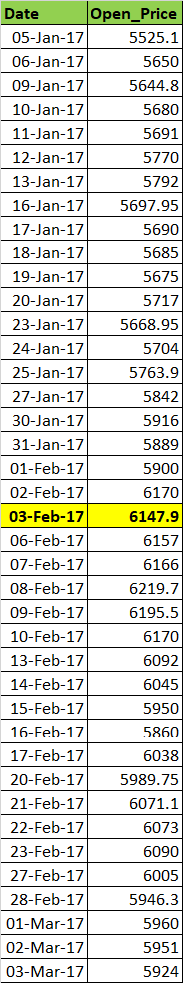
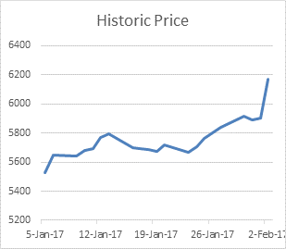
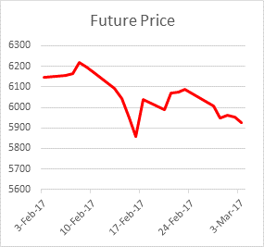
DEPENDENT VARIABLE
The Dependent variable is the final Label which classify BUY or SELL for a holding by considering all the Technical Parameters and Stock Values.
SPFR Model’s Prediction Labels have been trained on the Historic vs Future Learning, Model evaluates the relation of historic Technical Variables with the Future Market value to make better predictions
Predicting for 3rd Feb
Based on Historical Data, investor would have preferred BUY
But with the knowledge of Future Data, SELL is more preferred Option
CLASSIFIERS
If the Stock Value increases in Future with minimal fluctuation and tends towards stability, Model Predicts it as POTENTIAL BUY
If the Stock Value increases in Future but the each day fluctuation increases. Model considers this as less stable stability and predicts
as RISKY BUY
If the Stock Value decreases in Future, Model considers this as SELL
SPFR Model consider 20 Day Window (Both Historic and Future)

Slide 14
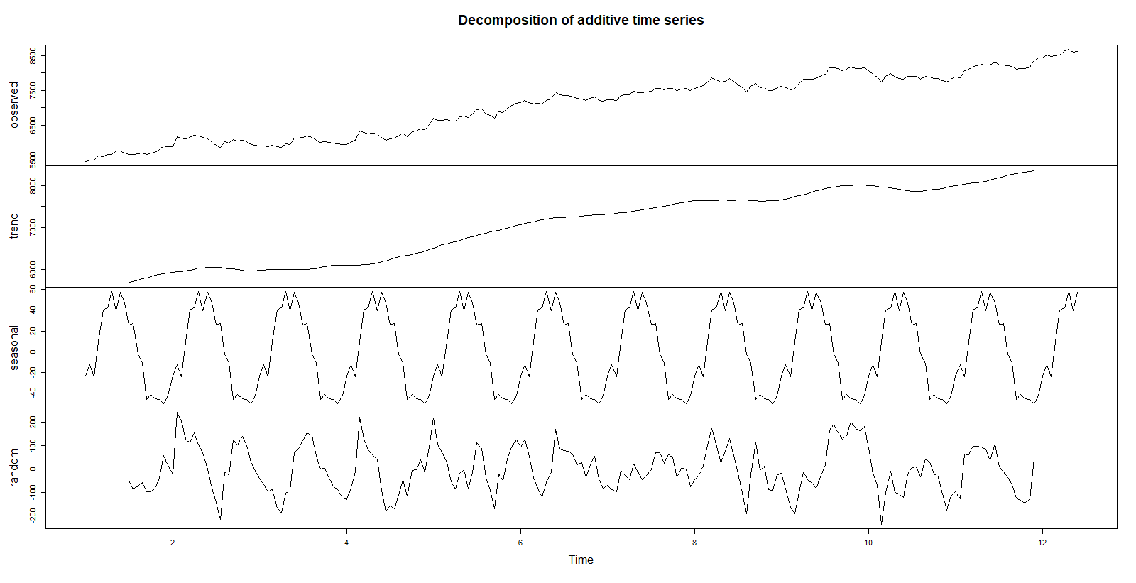
FORECASTING
Stock Market data is not a linear data, which makes it challenging to perform the forecasting. Post Decomposition of time series, Model witnessed the Seasonality and Non Stationary element, Also the data is on day to day basis, hence finding the optimum frequency for the forecast was the most essential part.
DECOMPOSITION OF TIME SERIES
Time Series reflects that there is component and Seasonality
Its also evident that the Time Series is not Stationary

Slide 15
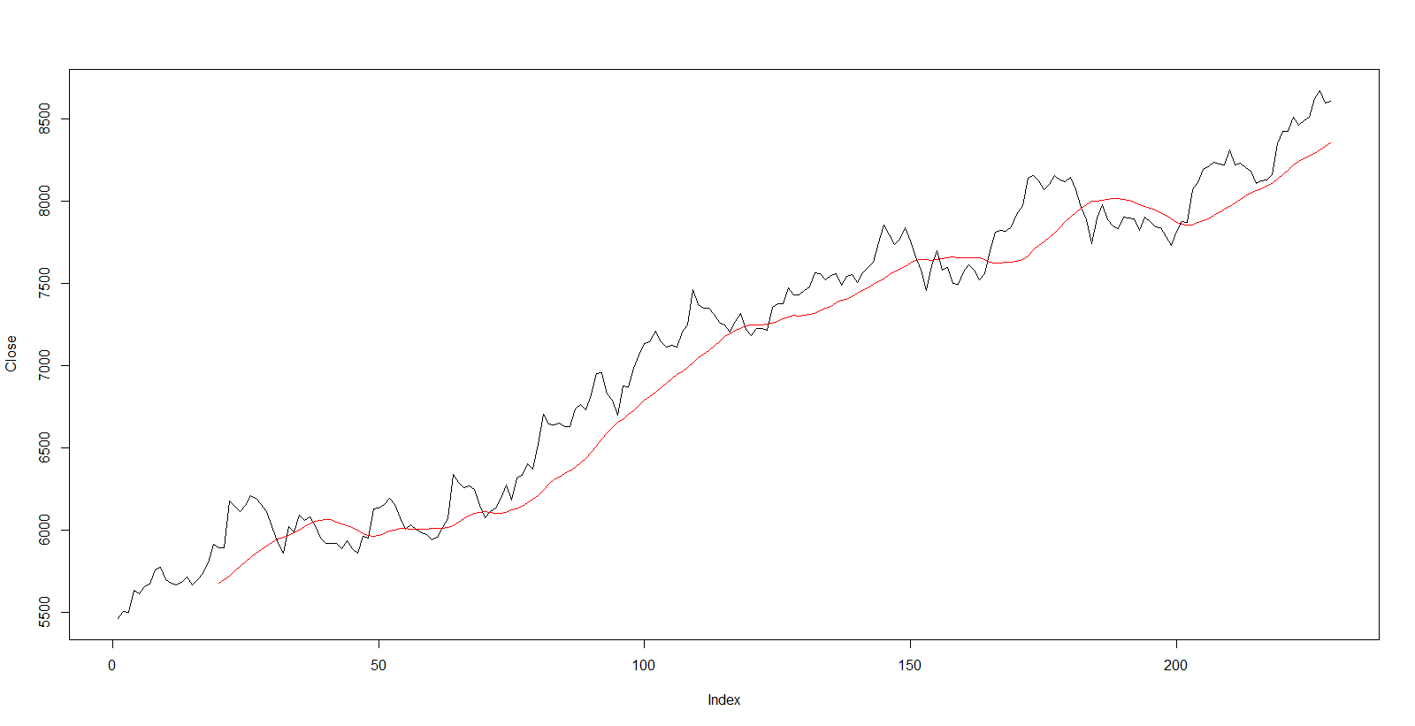
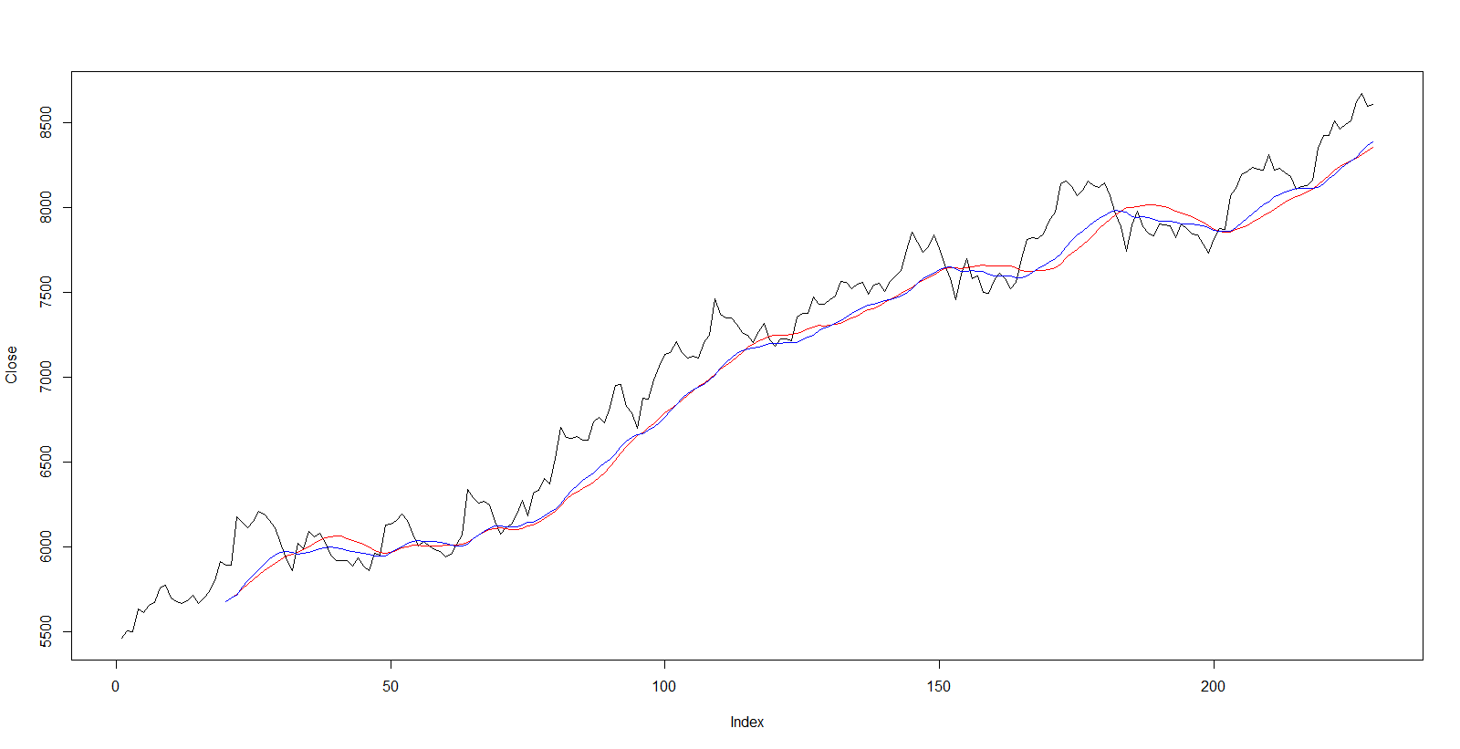
FORECASTING
Once the time series is made stationary and seasonality is addressed, the right fit of forecasting technique is needed.
SIMPLE MOVING AVERAGE
The red line depicts SMA with frequency of 19 days.
SMA
EXPONENTIAL MOVING AVERAGE
The red line depicts SMA and Blue line
depicts the EMA
SMA vs EMA
Although, EMA is better than SMA, but it’s far from accurate

Slide 16
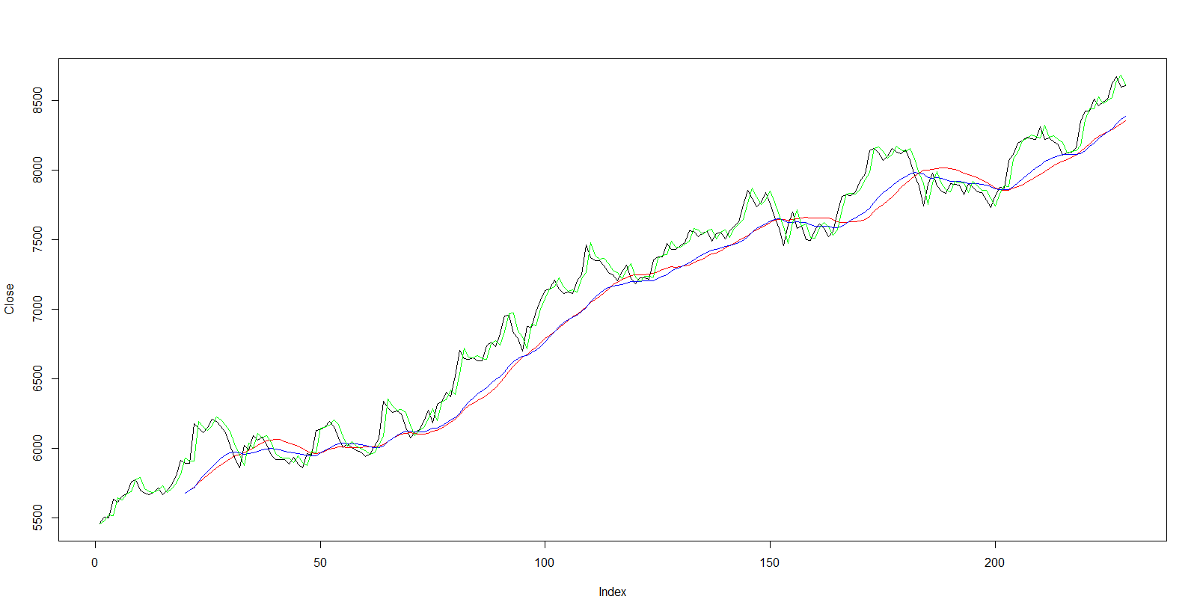
FORECASTING
Auto Regression Integrated Moving Average
ARIMA
SMA vs EMA vs ARIMA
The Green line depicts ARIMA, in this comparison it is visible that ARIMA fits the trend perfectly viz a viz SMA and EMA
Post testing for ACF and PACF, and identified the optimal value for P,Q,R we applied the AUTO ARIMA
ARIMA stands out far more the best technique for Forecasting

Slide 17


MACHINE LEARNING
The preferred choice of model for SPRF was Random Forest, but we tested learning on SVM, KNN for comparison purpose
SUPPORT VECTOR MACHINE – LINEAR
SVML <- svm(train$PredictY ~ ., + data = train, + kernel = "linear")
The SVM Linear Model Accuracy is " 63.63%
SUPPORT VECTOR MACHINE – RADIAL
SVMR <- svm(train$PredictY ~ ., + data = train, + kernel = "radial")
The SVM Radial Model Accuracy is " 63.63%
KNN
KNN_pred = knn(train = Xtrain, + test = Xtest, + cl = CLY, + k = 5, + prob = TRUE)
The KNN Model Accuracy for k = 5 is " 53.63%
The KNN Model Accuracy for K = 7 is " 52.72%
The KNN Model Accuracy for K = 3 is " 55.45%

Slide 18
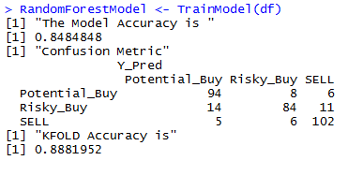

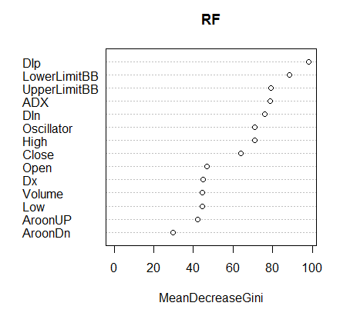
MACHINE LEARNING
Random Forest
Gini Index
Tested on more than 6 different Stocks, Random Forest gave consistently 82% and above with minimum KFOLD Accuracy of 85%

Slide 19
TEST OF CONCEPT
Proof of the pudding is in the pudding

Slide 20
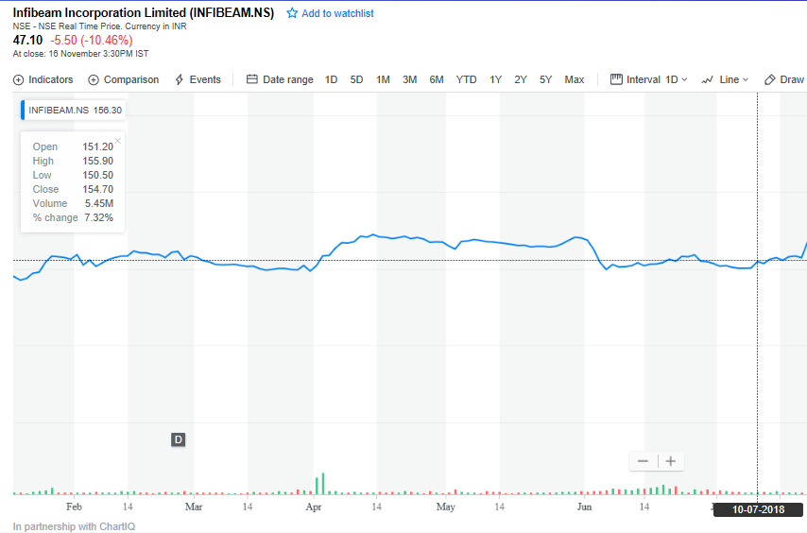
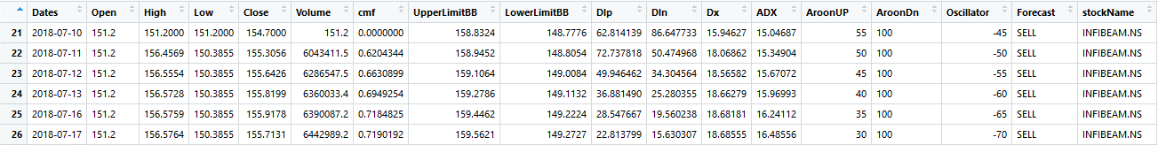
To Test the accuracy of the model, we chose a Volatile stock and analyzed the results with the actuals
We analyzed the Infibeam on various stages to observe the results
INFIBEAM STOCK MARKET FOR 10th July 2018
INFIBEAM is priced at 151.20 And appears steady
Model Prediction says
Probability of Price might go down in next 20 Days is with 76.19 %

Slide 21
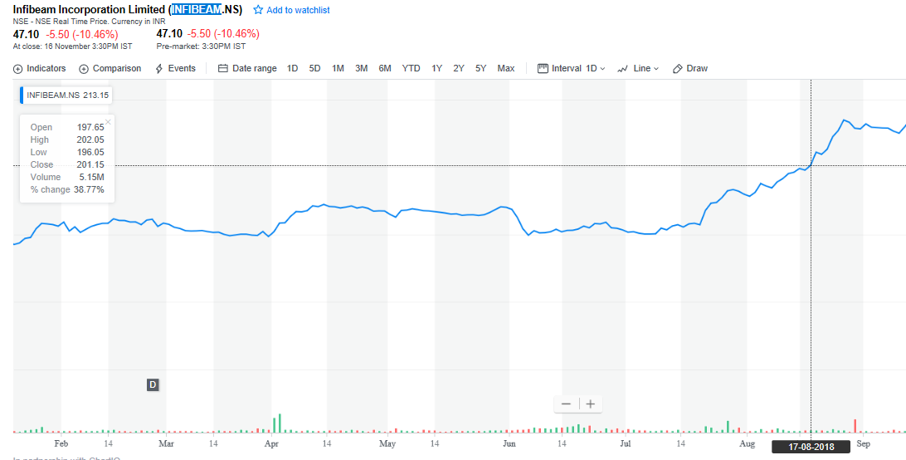
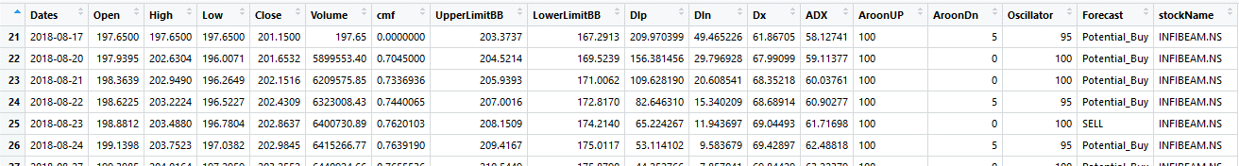
After One Month
With a steady increase, INFIBEAM Climbed to 197 from 151.20, with 21% Increase
Model Prediction says,
POTENTIAL BUY
Probability of Price might go up in next 20 Days is 95.24 %

Slide 22
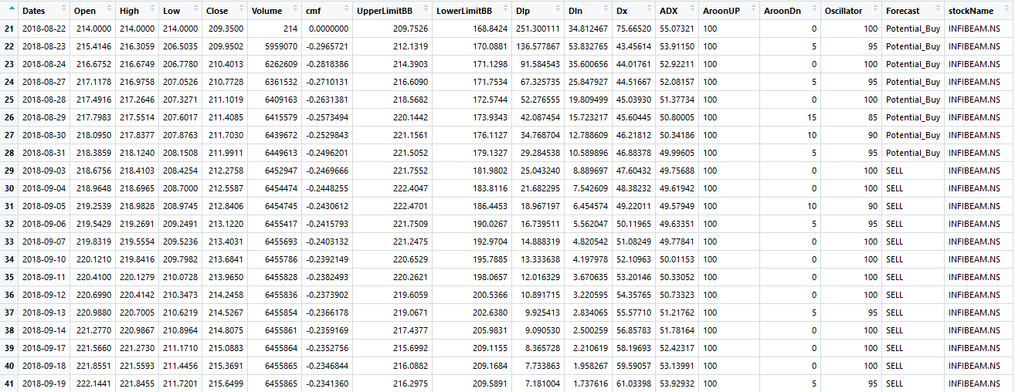
Test conducted on 20th August, Says,
Probability of Price might go up in next 20 Days is 90.48 %
For 22nd Aug, Model has mixed results, trend changes 3rd Sep Onwards…...

Slide 23
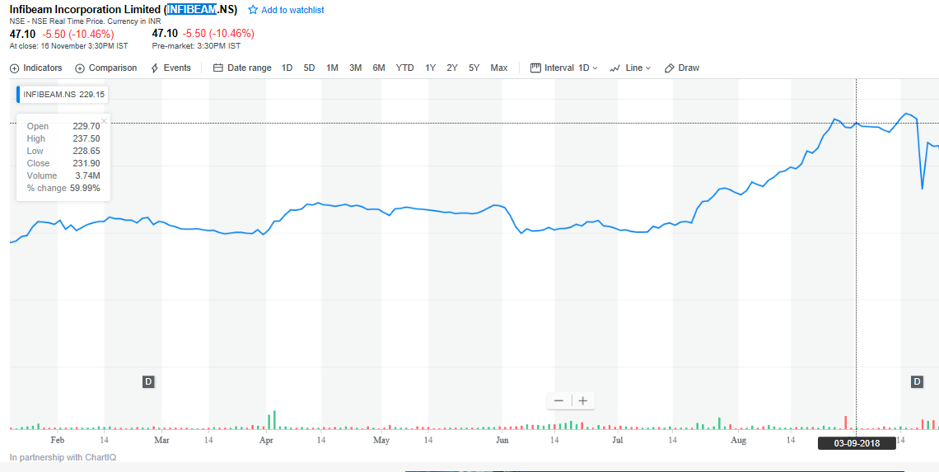
Stock Market Screenshot for Infibeam on 3rd Sep
Trend looks steady, with INFIBEAM Climbing even further to 229 from 191, with 19% Increase in Two Days
To verify the trend, Model was tested for 3rd Sep

Slide 24
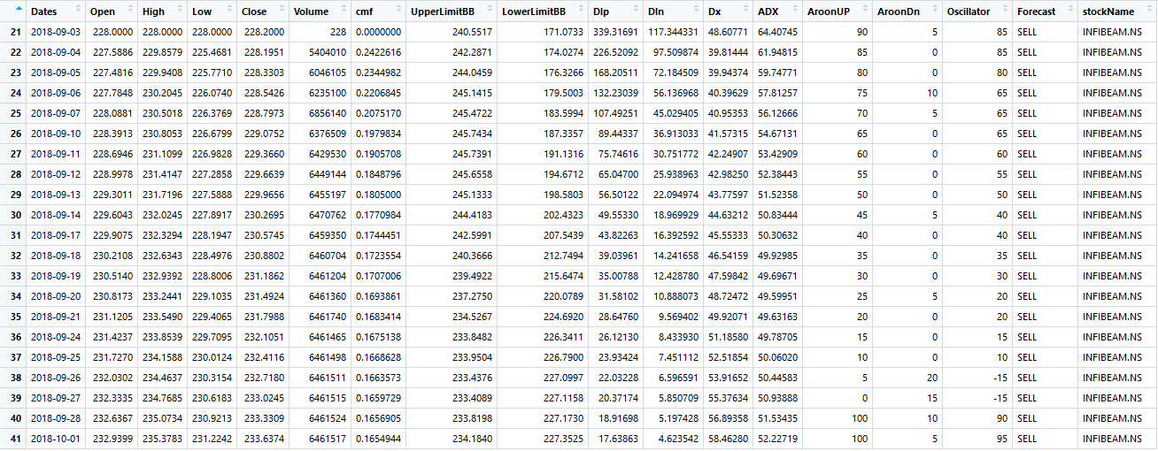
Model Tested for 3rd September gives a indication of STEEP FALL, however the previous graphs indicates strength and stability
Probability of Price might go down in next 20 Days is with 100 %

Slide 25
After 20 Days

Slide 26
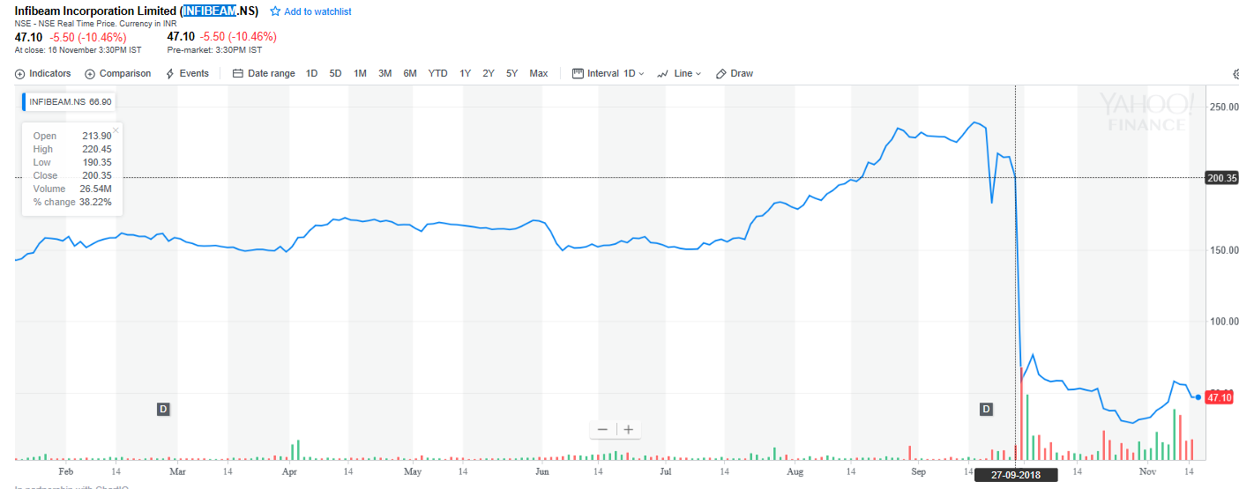
27th Sep witnessed the steep dive from 200 to 47, with approx. of 76.5% fall
The Steep decline of 27th Sep was well explained, 20 days before the fall, on 3rd Sep

Slide 27
CHARTS

Slide 28
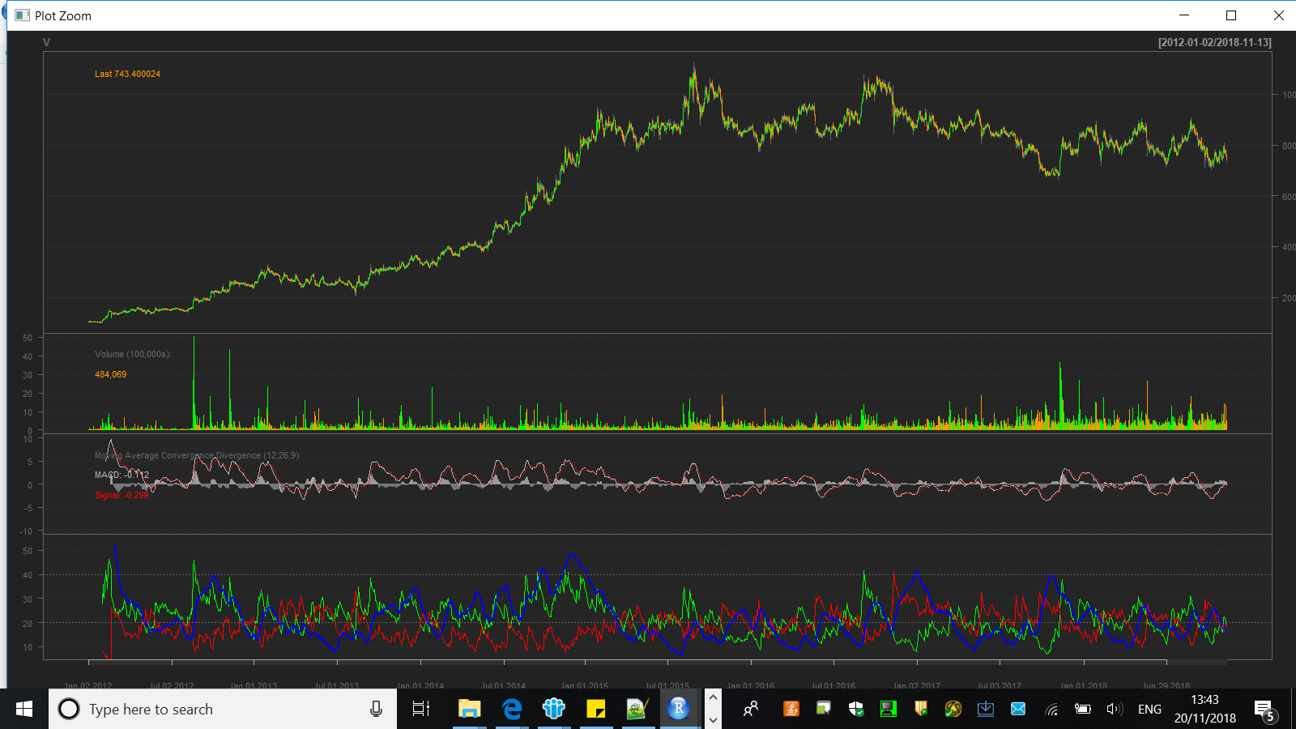
CANDLE-CHART
VOLUME
MACD
ADX

Slide 29
DEMO

Slide 30

Future enhancements
Incorporate Sentiment Analysis from Stock Trading Blogs/Social Media
Neural Network based Forecasting
Extend the Model to provide recommendations for Portfolio Management

Slide 31
THANK YOU

